Slide 1
VA Scheduling Contest
Intro to Vista and
OSEHRA’s role
May 21, 2014
Notes:
The slides included in this deck shows the precise formatting to use for the Title Slide at slide one of this template.

Slide 2
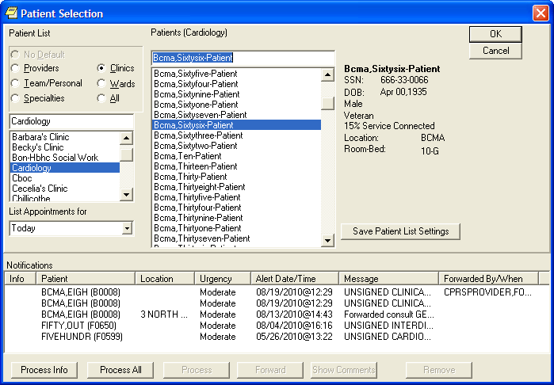
VistA
Veterans Health Information
Systems and Technology Architecture - is VA's award winning Health Information Technology (IT) system. It provides an integrated inpatient and outpatient electronic health record for VA patients, and administrative tools to help VA deliver the best quality medical care to Veterans.

Slide 3
By the Numbers …
Approximately 200 modules
Decades of development
Deployed at more than 1,500 sites
Veterans Affairs Medical Centers (VAMC)
Community Based Outpatient Clinics (CBOC)
Community Living Centers (CLC)
Nearly 300 VA Vet Centers.
~ 128 Packages in redacted FOIA
108 Packages undergoing certification
27,484 source code files (redacted version)
2,753,249 source code lines (redacted version)
http://www.ehealth.va.gov/docs/VistA_Monograph.pdf

Slide 4
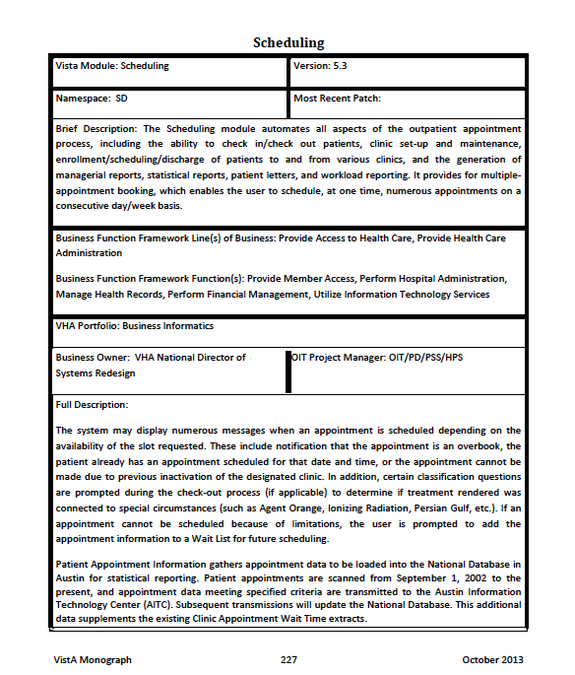
Including Scheduling
The package of the day …

Slide 5
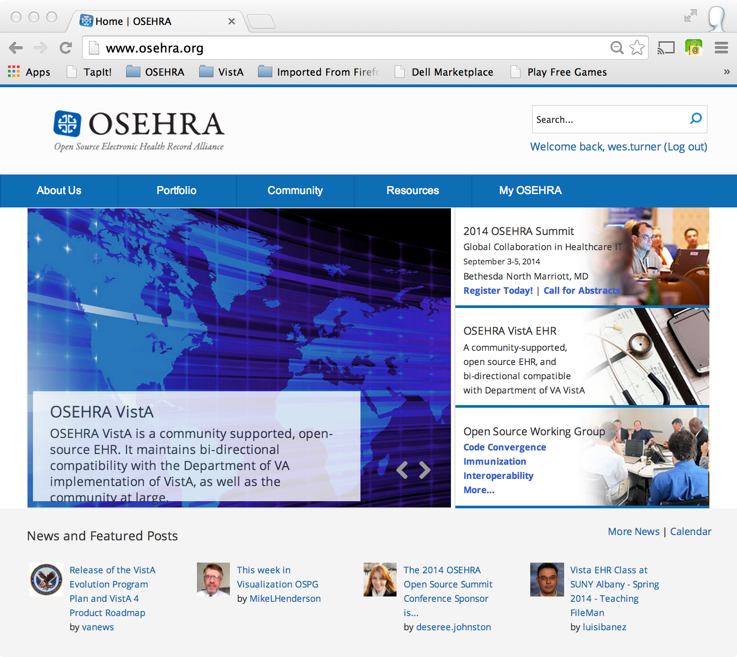
Open Source Electronic Health Record Alliance
"Build and support an open source community of users, developers, service providers, and researchers engaged in advancing electronic health record software and related health information technology." OSEHRA’s mission includes the creation of a vendor-neutral community for the creation, evolution, promotion and support of an opensource Electronic Health Record. This community will operate with the transparency and agility that characterize open source software initiatives. This entails not only the development of a community of software experts, clinicians, and implementers, but also a robust ecosystem of complementary products, capabilities and services.
http://www.osehra.org/

Slide 6
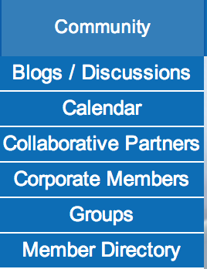
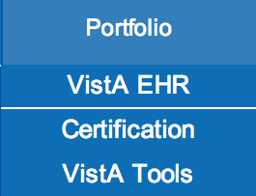
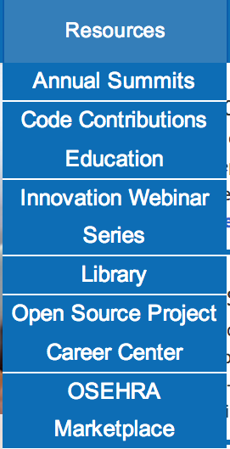
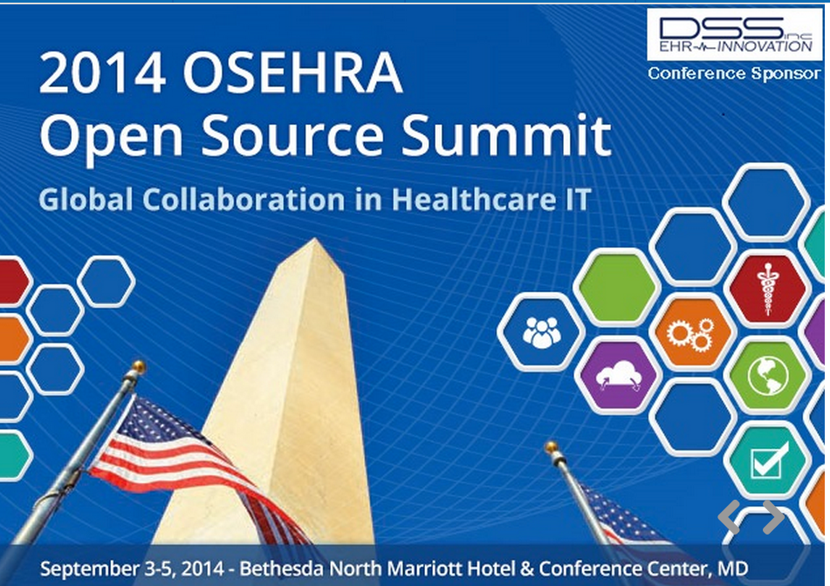
OSEHRA Services
OSEHRA Provides a number of services:
Distribution:
VistA FOIA
OSEHRA VistA
Community Building
Tools
Code Contributions
Repositories
Review
Webinars
Discussion/Working Groups

Slide 7
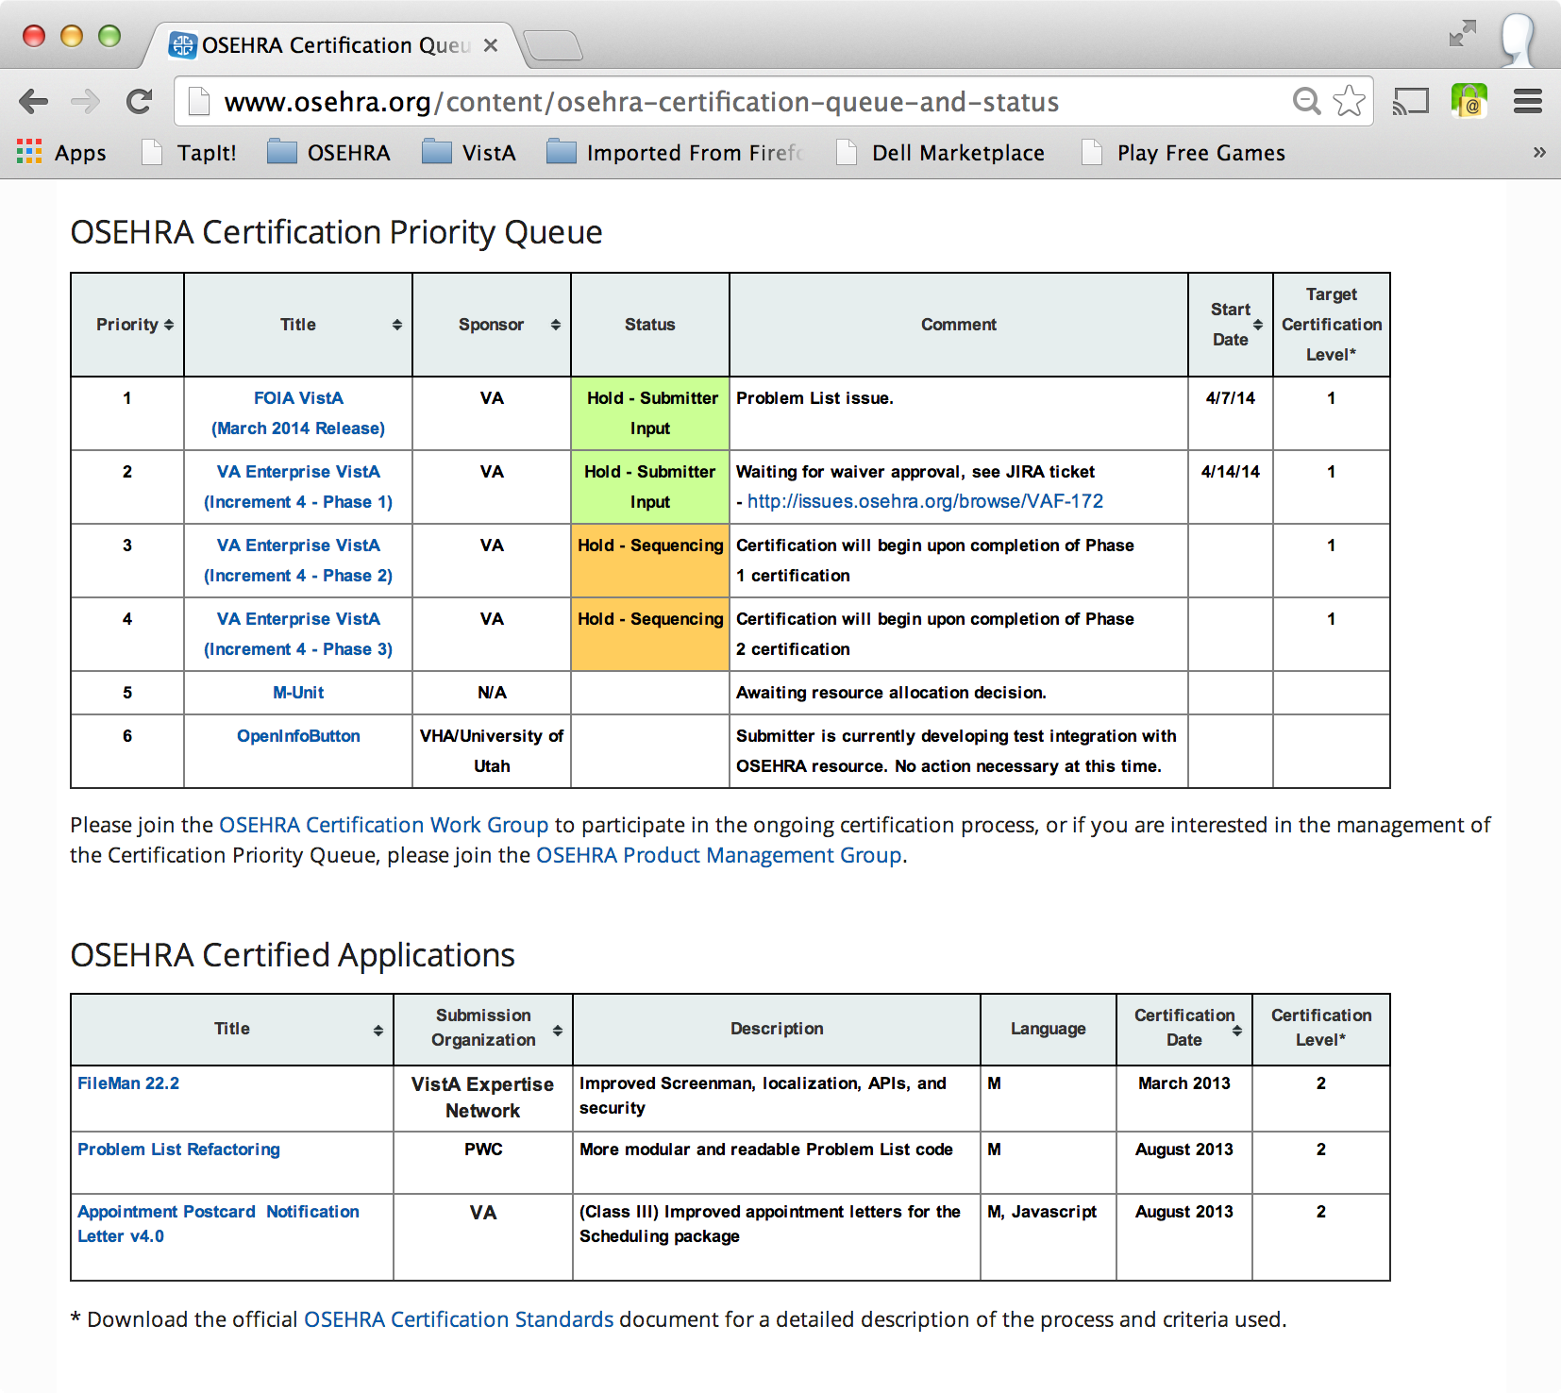
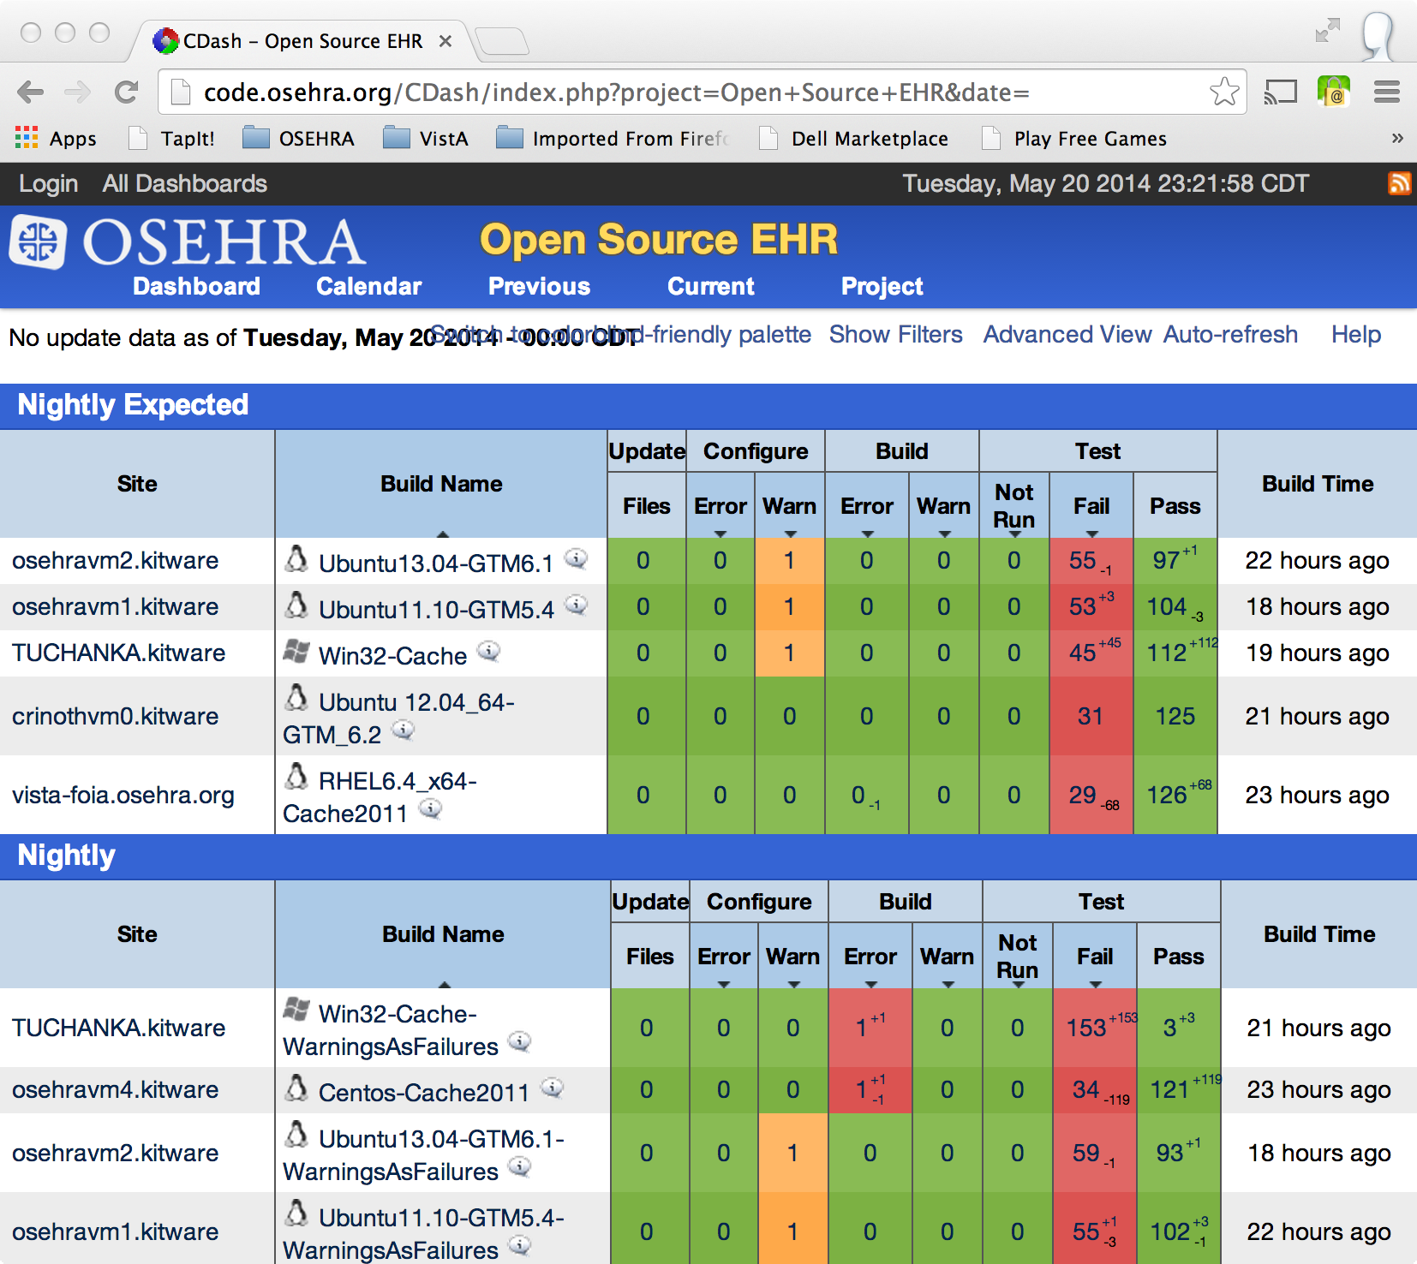
OSEHRA Services
And most importantly for the Scheduling Contest:
Testing
Certification

Slide 8
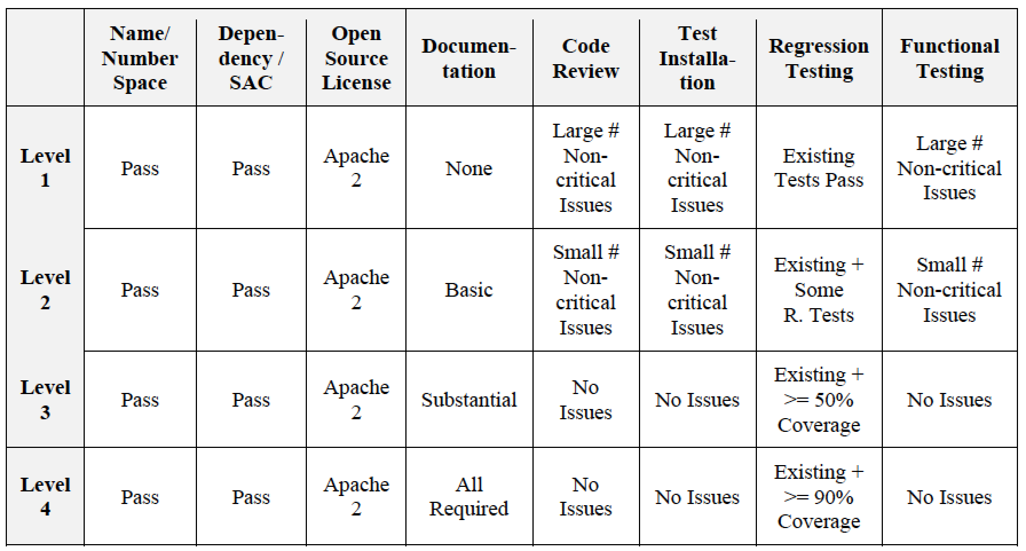
OSEHRA Services
And most importantly for the Scheduling Contest:
Testing
Certification
Standards

Slide 9
OSEHRA at the Contest
“As the custodial agent for an open source community of VistA developers and users, OSEHRA plays a central role in the distribution and certification of VistA and VistA-related software. Members of the OSEHRA community, both individuals and organizations, may develop contest submissions, singly or in collaborative groups, and community members may choose to use OSEHRA facilities (such as code repositories or working groups) during the development process. OSEHRA staff members will perform the first phase of contest entry evaluation and will have no affiliation with any contest submission. No member of the OSEHRA staff will participate in any discussion, work, or project group where contest submissions are discussed.”

Slide 10
Responsibilities
Configure a virtual testing environment:
Provides a representative multi-site VistA configuration.
Provides a largely identical environment for evaluating all contestant submissions.
Contestants will have sufficient control of the virtual machines (VMs) in which they will prepare their submissions.

Slide 11
Stage 1 Evaluation
Eight Use Cases:
ESTABLISH, ORGANIZE, AND MANAGE THE SCHEDULING COMPONENT
ESTABLISH AND MANAGE SECTION SCHEDULES
CREATE A PATIENT APPOINTMENT
MANAGE A PATIENT APPOINTMENT
MANAGE A WALK-IN PATIENT
CANCEL INDIVIDUAL APPOINTMENT
RESCHEDULE INDIVIDUAL APPOINTMENT
ADD APPOINTMENT REQUEST TO WAITING LIST AND SCHEDULE PATIENT FROM WAITING LIST

Slide 12
Step 2B Evaluation
Open Source Compatibility
License is Open Source (5 points)
Compatible with the Apache 2.0 License (2 points).
Use Apache 2.0 License (3 points).
Scheduling+VistA Integration code is openly available in the VM (5 points).
Overall descriptive documentation for the integration code (4 points).
Adequate documentation for code (APIs) and instructions for installation (4 points).
Integration code and modification to VistA pass the XINDEX SAC Checker (3 points)
If any M Routines have been modified, then the Routine Headers have been appropriately written/updated using this format (1 point):
Report on whether VistA modifications have appropriate MUnit tests (2 points).
Do the tests in Item 7 above pass (2 points)?
Do VistA modifications include installation method into current VistA-FOIA (2 points)
Does the installation method provided in Item 9 above install cleanly (2 points)

Slide 13
Important Note
OSEHRA provided an objective evaluation, but did not participate in the 2A evaluation (demonstration) or make any determination as to a winner.

